Slide 1

Requirements specification.
Screen map
E / R scheme
Logical model of the database.
Summary table
A description of the data loaded into the database
Discordia

Slide 2
EXTENSION | IMPLEMENTED
Self-registration | YES
Password recovery | NO
Messages to several recipients | YES
Encrypted user password | YES
User avatar | YES
User profile | YES
Friendship | YES
Groups | YES
Administration zone | YES
Attached files | YES
Images | YES
AJAX | YES
Presentation | YES
Requirements Specifications

Slide 3
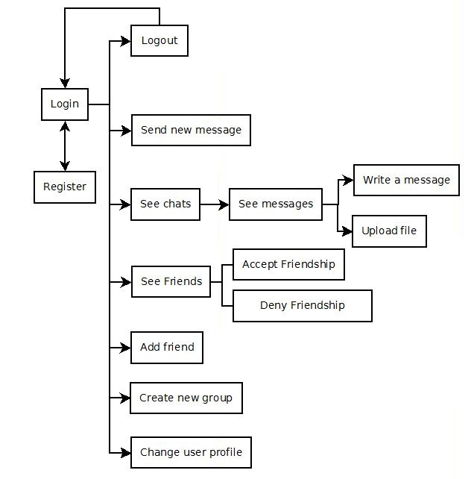
Screen
Map

Slide 4
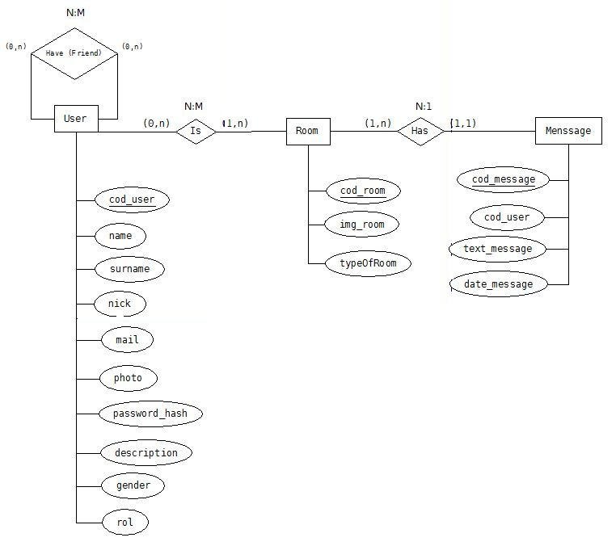
E-R
Scheme

Slide 5
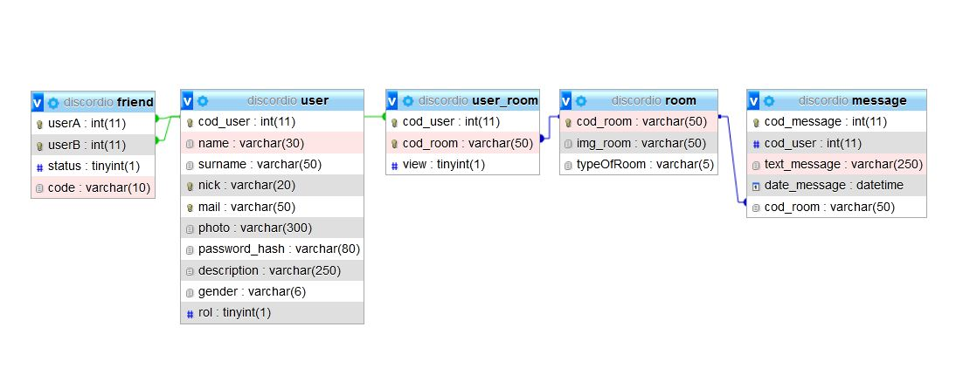
Logical Model of the Database

Slide 6
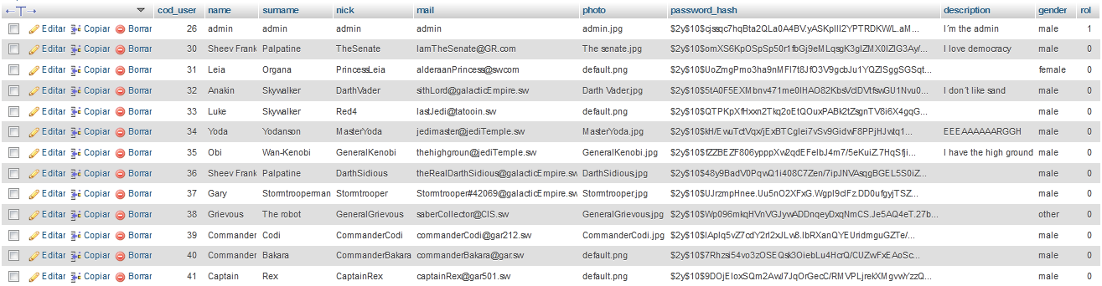
Data into
The database

Slide 7
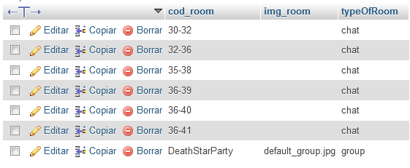
Room Table

Slide 8
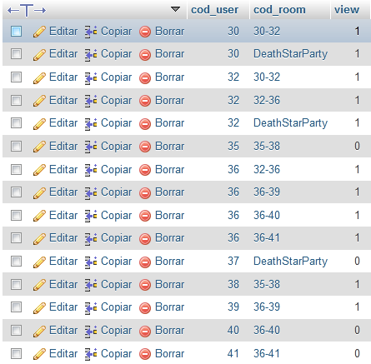
User_Room Table

Slide 9
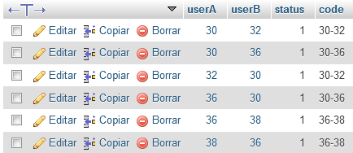
Friend Table

Slide 10
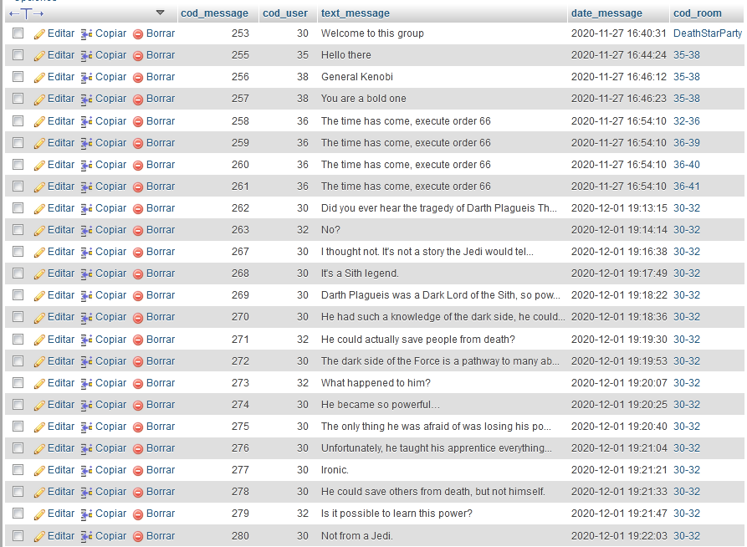
Message Table

Slide 11
DEMO
DANIEL

